Slide 1

Oil & Gas Company Proposal
Sep 2019

Slide 2
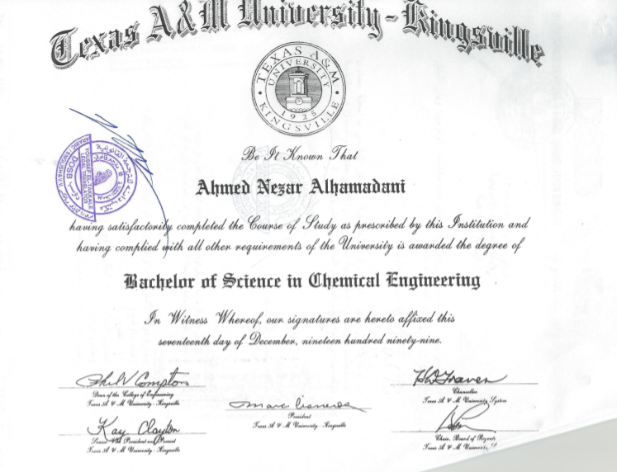
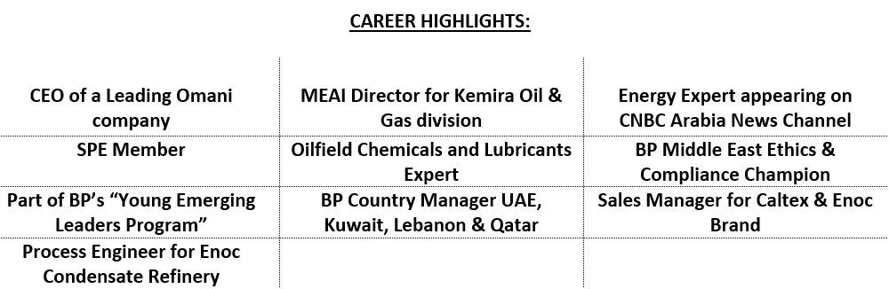
Ahmed Al-Hamadani Profile & Background
A result-oriented Chief Executive Officer with a solid reputation for starting up companies by providing Strategic Direction and Implementation; Cost Optimization and Profit Maximization.

Slide 3
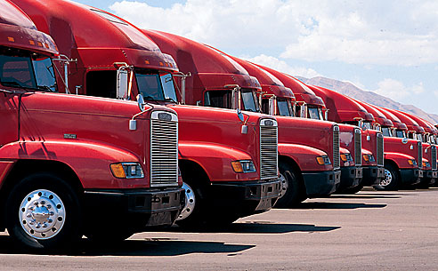
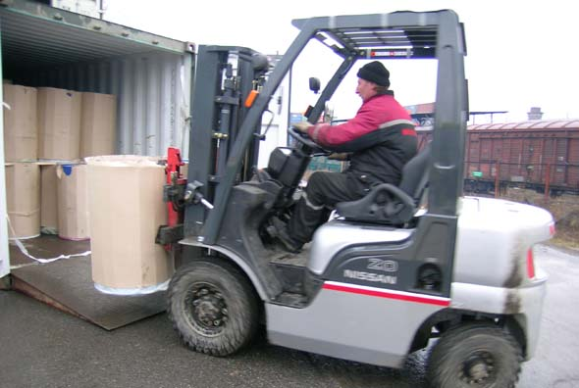


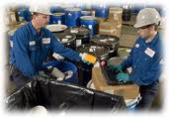
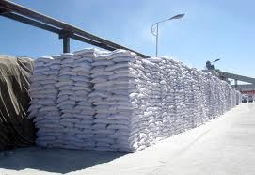
Vision
Formation of a highly reputable Oil & Gas trading company that is specialized in Procurement, Trading and Services. Focus segments would be Oilfield Chemicals complemented by owning a blending facility that provides numerous products, OCTG, Lubricants and PPE.
In addition, this company would be supported by maintaining fully equipped facilities, including Laboratory, sizable warehousing & offices as well as a complete distribution network all staffed by personnel who are able to service customers in MENA region.
Key operations need to be in place while leaving a multitude of important tasks to this Organization, examples include:
Sales & Marketing
Customs Clearance & Forwarding
Financial Services
Infrastructure & Logistical Support such as offices & warehousing, transportation & delivery, personnel and general management

Slide 4
Main Focus Segments
Asset Integrity Management (AIM) Services
Our specialists provide support in all areas of Asset Integrity Management, including mechanical integrity, inspection and maintenance and supply of Material
Oilfield Chemicals
Chemical treatment to oil and gas, starting from production level to final consumption, plays very import role in oil and gas industries. This will be the main focus for our company
OCTG
Oil country tubular goods (OCTG) is a family of seamless rolled products consisting of drill pipe, casing and tubing subjected to loading conditions according to their specific applications. There are huge requirements for these products in the Oil & Gas
Our role is to create exclusive agencies with leading principals and bring new technologies to MENA region. We will support our principals by helping them market and sell their products to the Oil & Gas sector.

Slide 5
Our Services
Equipment and Chemical supplies
Stock items for our customers at our own warehouses to ensure that there are always stock available to meet their needs or we provide them with Custom Store options at their own dedicated sites.
Procurement & Sourcing & AIM
To Procure products through a network of Principal companies that we will represent and thru international procurement representatives in USA, India, China, Europe and Middle East. To have a fully-dedicated experienced team with Engineering backgrounds and technical knowledge to ensure we get the best products at the best price possible.
Logistics Management & Customer Service
To have dedicated employees who manage our customers logistics needs for “door-to-door” product delivery working with local and global freight forwarders and shipping lines 24hr/7.

Slide 6
Our Focus Markets
Other Region
Canada
USA
Indonesia
Pakistan
Libya
Egypt
MENA Region
Iraq
Oman
Kuwait
Qatar
Algeria
Nigeria

Slide 7
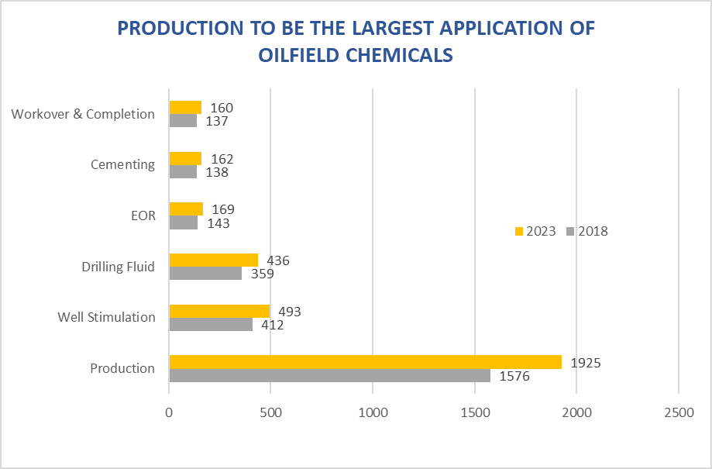
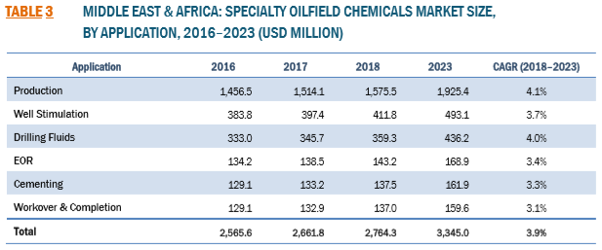
Oilfield Chemicals Market Size

Slide 8
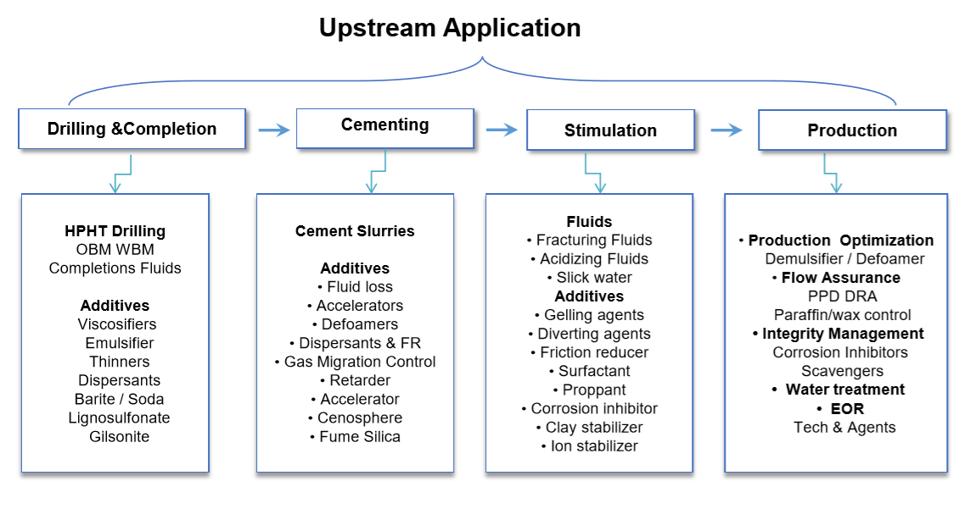
Oilfield Chemicals Segments

Slide 9
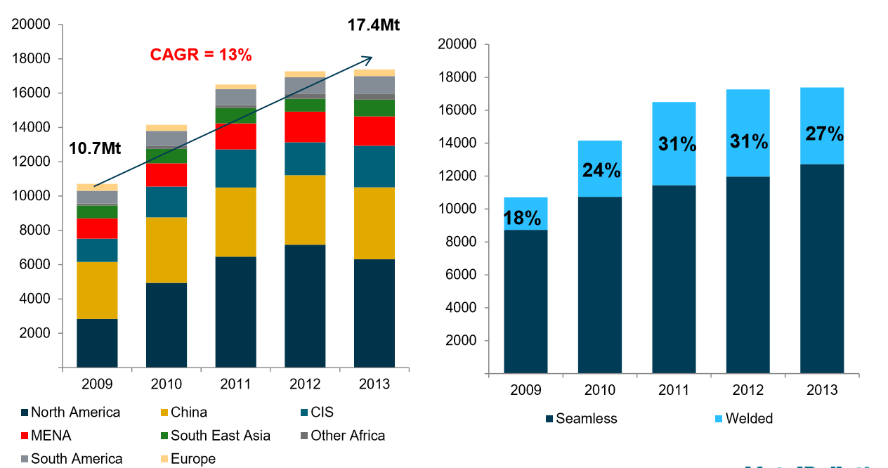
OCTG Segments - Pt1

Slide 10
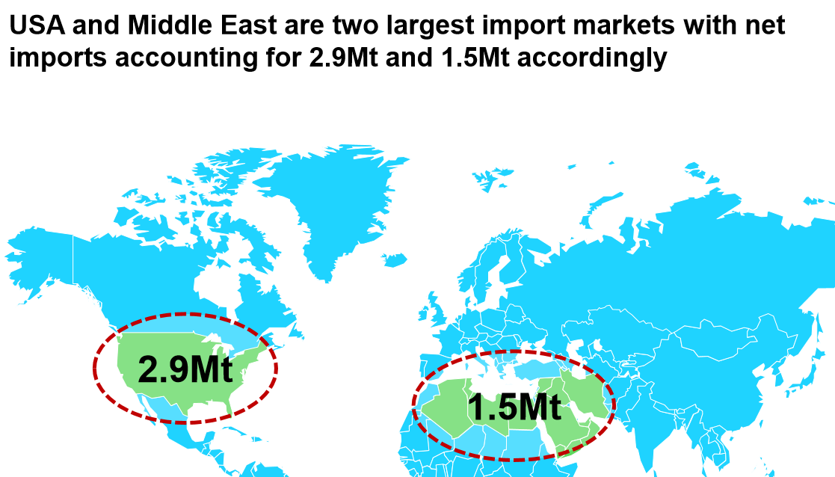
OCTG Segments - Pt2
Middle East Market is estimated at $3.44 Billion (Total market is estimated at $43 Billion)

Slide 11
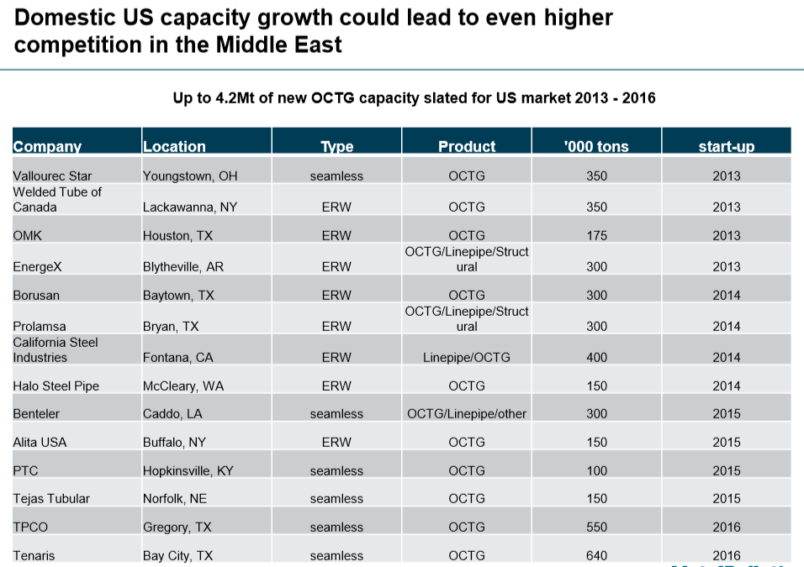
OCTG Segments - Pt3

Slide 12
OCTG Segments - Pt4
Goal is to establish direct connections with A-Class MILLS across the globe and provide supply and service to our clients.
Products will be certified by approved Third-Party inspectors.
Entire delivery process will be supervised by the team.

Slide 13
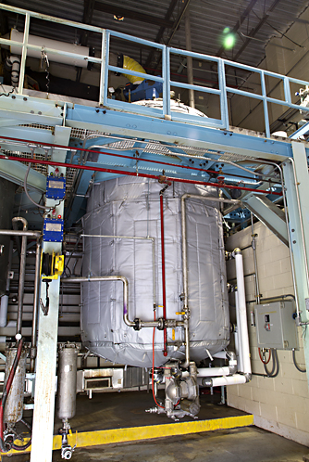
Phase 1
Blending
Chemical mixing
Dispersions & Emulsions
Focus on Production chemicals & Drilling Products
Analytical capabilities and product customization
Phase 2
Blending and Chemical Reactions
Creating new molecular entities through chemical reactions of gaseous, liquid or solid raw materials
Advance analytical capabilities
Phase 3
Product Development
Synthesis and process development
Applications testing lab
Scale up and pilot plant facilities
Chemical Blending Roadmap

Slide 14
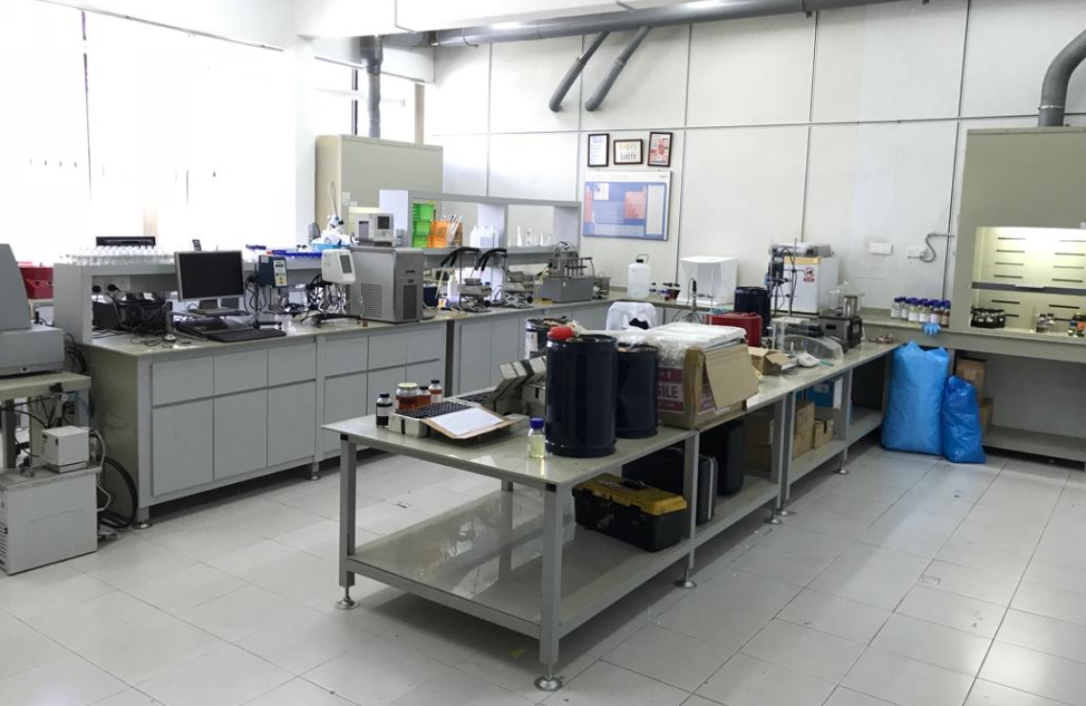
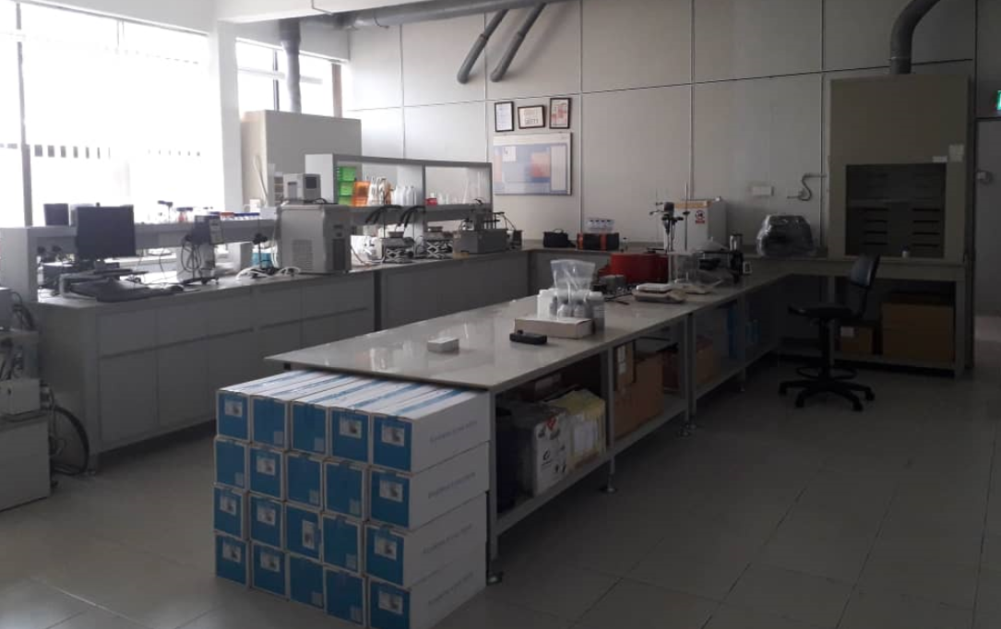
Laboratory
Full Range Laboratory can be set up which will take care of the Production Chemicals as well as Quality testing like Barite, Bentonite, Calcium Carbonate, Liquid Blending, Solid Blending and all related mud additive used in Water Base Mud, Oil Base Mud, etc.
Lab will be built to do Quality Test, Customization of Products specifically for Demulsifiers and Future product development.
Size 400-500 sqft

Slide 15
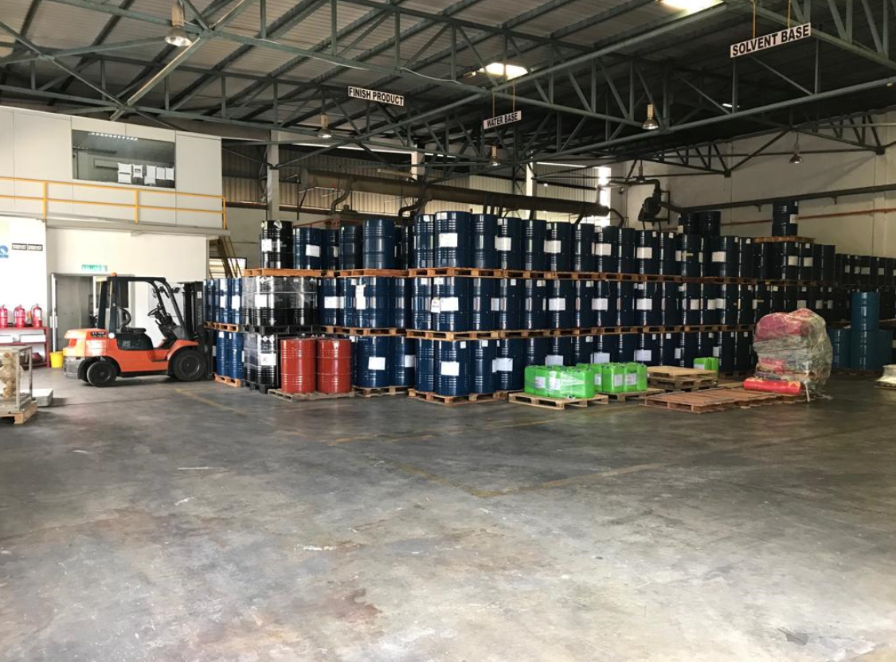
Investment requirement for a Medium Size Fit for Purpose Blending Facility is $1-$2Million.
Detailed Feasibility Study will be shared with Potential Share Holders.

Slide 16
Chemicals which requires only blending – Phase 1
Temperature Stabilizer
ROP ENHANCER
CLOUD POINT GLYCOL – MEDIUM, HIGH, LOW.
Drilling Detergent
Liquid PAC, Xanthan Gum, HEC
Rig Wash
HT Thinner
Silicate Lubricant
CMS
Liquid PHPA
Demulsifier
Estimated Investment at Phase 1 - $1Million which includes the blending plant and Office building

Slide 17
LIQUID PLANT – Phase 2 (with Reactors)
Production Unit | USD 1.2 MILLION
R&D LAB | USD 200,000
QA/QC & MUD LAB | USD 200,000
TOTAL ESTIMATE (EXCLUDING LAND & BUILDING) | USD 1.60 MILLION

Slide 18
Plant Requirements
Sl. No. | Requirements | Required No | Approximate Cost in USD
1 | Reactor | 6 | 215000
2 | Condenser | 4 | 6000
3 | Vacuum pumps | 4 | 11600
4 | Pipe Lines & Motors | - | 36500
5 | Cooling Tower | 2 | 29000
6 | Thermic Fluid Heater | 2 | 87000
7 | 50 KL Storage tanks | 6 | 87000
8 | Platform | - | 29000
9 | Load Cells & Weighing Scales | - | 43500
10 | Fork Lifts | 2 | 29000
11 | Trolleys & Drum Lifters | - | 7300
12 | DG | 1 | 29000
13 | Lab Equipments | - | 215000
14 | Ramps | 2 | 29000
15 | Automated Filling Machines | 2 | 29000
16 | Truck | 2 | 80000
17 | Four Wheelers | 3 | 60000
18 | Miscellanious | - | 14500
Total Cost excluding Land Cost & Building Cost |  |  | USD 1,037,400

Slide 19
Estimated Output per Month – Phase 2
Liquid Plant(PER MONTH)
PRIMARY EMULSIFIER | 750 DRUMS * USD 275 = USD 206,250
SECONDARY EMULSIFIER | 500 DRUMS * USD 300 = USD 150,000
WETTING AGENT | 500 DRUMS * USD 275 = USD 137,500
RHEOLOGY MODIFIER | 500 DRUMS * USD 425 = USD 212,500
OBM THINNER | 300 DRUMS * USD 300 = USD 90,000
LIQUID GILSONITE | 500 DRUMS * USD 350 = USD 175,000
RADIAGREEN LUBRICANT | 1000 DRUMS * USD 500 = USD 500,000
OTHER LUBRICANTS | 1000 DRUMS * USD 275 = USD 275,000
GLYCOLS | 1000 DRUMS * avg. USD 250 = USD 250,000
DEFOAMERS (SILICON, ALCOHOL & GLYCOL BASED) | 1100 DRUMS * avg. USD 250 = USD 275,000
POLYAMINE | 1000 DRUMS * avg. USD 450 = USD 450,000
OTHER LIQUID PRODUCTS (BIOCIDES, CORROSION INHIBITORS, ROP ENHANCER, Starch, Liquid PHPA ETC) | 1000 DRUMS * avg. USD 275 = USD 275,000
GROSS REVENUE FROM Liquid Plant | USD 2,996,250
Approximate NET PROFIT | USD 3,317,000 * 15% = USD 449,437.5

Slide 20
Required Staff for a Fully-Functional Plant
FM / AVP
Production Incharge
Admin Incharge
R&D Incharge
QC Incharge
Operator
Operator
Sales
Procurement
HR
Accounts
R&D Chemist
R&D Chemist
Lab Chemist
Lab Chemist
Marketing
Executive
Executive

Slide 21
Company Profile/Requirement
Ideally Company will be part of a well-established Holding company or has sister companies has strong financials which can support to register with Operators
Sister companies are well-established in the Oil & Gas industry even if they are catering to different segments
Establish the main trading office in Freezone UAE or Oman however company should be registered as a European company

Slide 22
First Year Plan
Setup company identity website, logo, etc.
Setup the team
Get ISO certificates and other Oil & Gas certificates
Signup agency agreements with global manufacturers to boost company profile
Prepare tender documentations
Signup with operators across MENA region
Identify blending company to purchase or setup preferably in Europe
NO Sales First Year in the budget

Slide 23
Financials
First year – required $600k as Operational costs of Setup for Main office
Second year - $300K as Operational Costs of Setup
Blending facility - investment $1-2 million
Operational credit line - $1-2 million
Total investment $4-5 million
Sweat Equity (CEO) - 40%
Shareholders Equity - 60% {$4-5million}

Slide 24
Company Cost Structure
Main Office
CEO - $16K/Month
Oil & Gas Business Development manager - $8K/Month
Oilfield Chemicals Engineer - $3.5K/Month
OCTG Sales Engineer - $3.5K/Month
Asset Integrity Engineer - $3.5K/Month
Procurement executive - $2.5K/Month
Logistics Coordinator - $2.5K/Month
Accountant - $2.5K/Month
Total Monthly Salaries - $42K/Month
Office Monthly Rent - $4.5k/Month
Monthly office expenses - $5K/Month
Total Monthly Expenses - $51.5K/Month

Slide 25
Thank you

